Slide 1

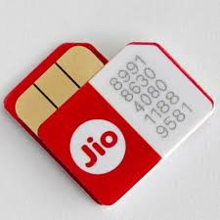

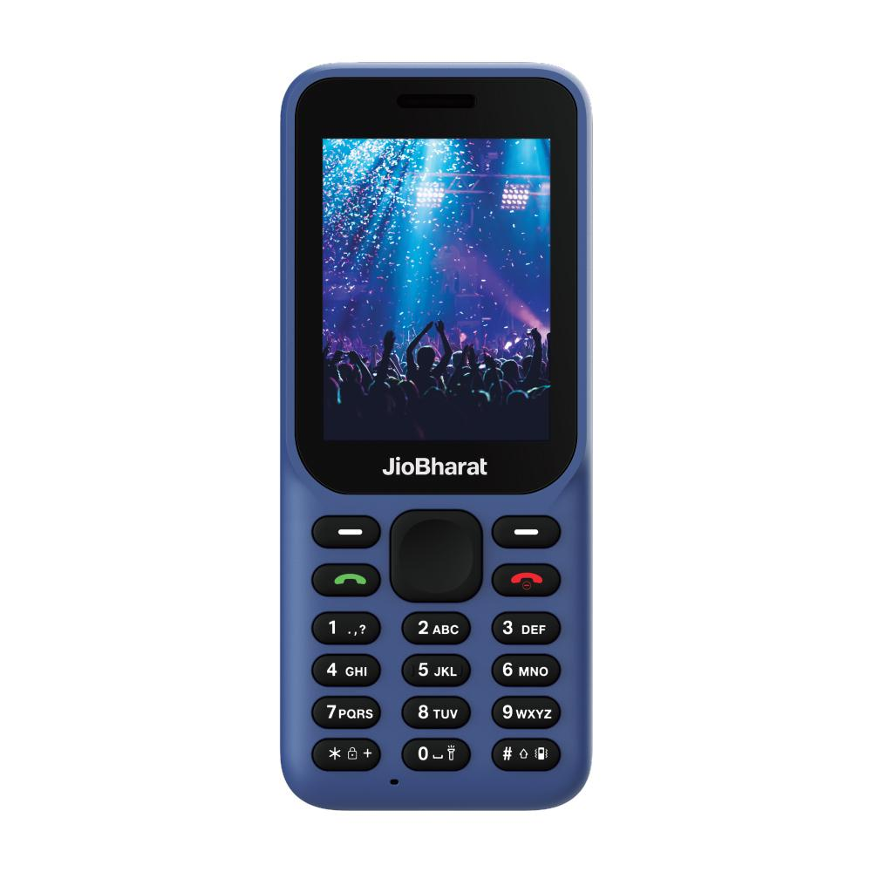
JIO Regional Distributor
Mobility Business- Device, Sim Card & Recharge

Slide 2
Regional Distributor (RD)
Sahaj has been onboarded with Reliance Retail Limited as a Zonal Distributor (ZD)
As per RRL we are allowed to onboard Distributors / Param Mitrs (Also referred as Regional Distributors (RD)) who can pay a Fixed One-time amount to become a Distributor.
Hierarchy (Top to Bottom)
Zonal Distributor (ZD) - Sahaj Retail Limited.
Regional Distributor (RD) – PM/ SM who is willing to invest
All the RDs will be onboarded from four Zonal Locations
North East West South

Slide 3
Responsibilities
Activity | Sahaj | Regional Distributor | Retailer
On Boarding | On Board Regional Distributors | On Board Retailers | Service Customers
Documents | Collect and Assist RD to provide required documents and create PRM ID | Collect and Assist Retailers to provide required documents and create PRM ID and SM ID
Initial Order | Place Order on behalf of RD for Phones, SIM and Recharge. Delivery to be done by RIL to RD. | Pay Roll Out Fee and after receipt of Initial Order, send to Retailers | Service Customers - Sell Phones, First Recharge, MNP and on-going Recharges.
On Going Orders | Place order to RIL on behalf of RD as per order and payment received for Phones/Recharges. | Send consolidate requirement of his/her Retailers and give order to Sahaj along once the payment is done through SKASH recharge. Send details at our email id jiodistributor@sahaj.co.in | Give requirement to RD
Commission | Recharge: Recharge Value is credited with commission. Example, if RD transfers 50,000, then Rs 50,200 will be credited in RD Wallet. Phones: Phones are sold as Discounted value to RD. | Recharge: RD transfers to Retailer wallet as per mutually agreed sharing between them. Phones: RD sells phones to Retailer as per RIL defined rates. | Recharge: Gets commission as per the Retailer commission Structure for the Recharge, MNP or FCR done. Phones: Buys phones from RD as discounted rate and sell at MRP to customer.

Slide 4
Plans
 |  |  |  | Current Pack |  |  | Pack 1 |  |  | Pack 2 |  |  | Pack 3 |  |  | Pack 4
Category | Market Price | RD to Pay |  | Count | Current Pack |  | Count | Pack 1 |  | Count | Pack 2 |  | Count | Pack 3 |  | Count | Pack 4
999 Device | 999 | 899 |  | 10 | 8990 |  | 10 | 8990 |  | 10 | 8990 |  | 10 | 8990 |  | 10 | 8990
1299 Device | 1299 | 1149 |  | 10 | 11490 |  | 10 | 11490 |  | 10 | 11490 |  | 0 | NA |  | 0 | NA
2599 Device | 2599 | 2349 |  | 10 | 23490 |  | 0 | NA |  | 0 | NA |  | 0 | NA |  | 0 | NA
Recharge | - | 50000 |  | 0 | 50000 |  | 0 | 50000 |  | 0 | 25000 |  | 0 | 20000 |  | 0 | 1000
SIM | - | 10 |  | 1000 | 10000 |  | 1000 | 10000 |  | 1000 | 10000 |  | 1000 | 10000 |  | 100 | 1000
Roll Out | - | 10000 |  | NA | 10000 |  | NA | 10000 |  | 0 | 10000 |  | 10000 | 10000 |  | 0 | 10000
Total Amount |  |  |  |  | 113970 |  |  | 90480 |  |  | 65480 |  |  | 48990 |  |  | 20990

Slide 5
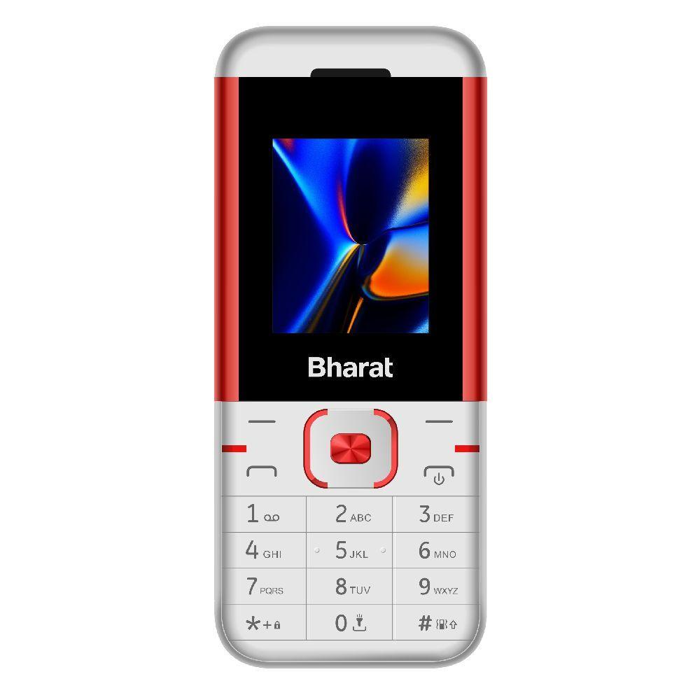
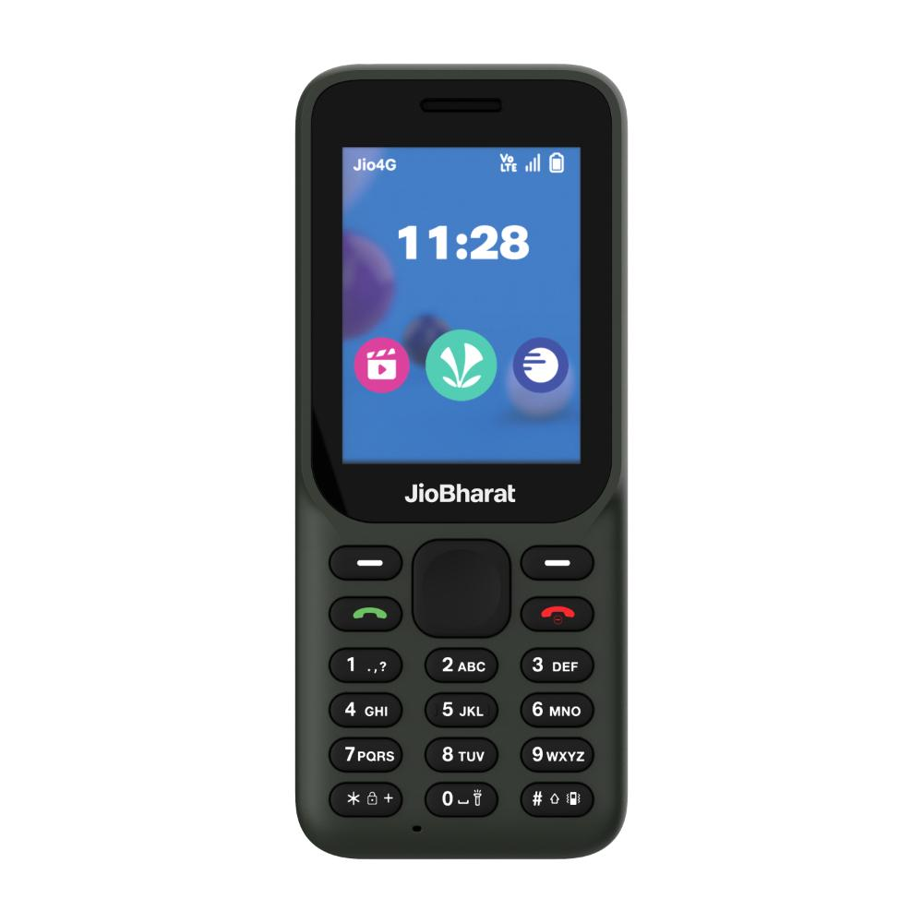
Handset Features
999 Jio Bharat Mobile Device
With Jio Cinema
Jio Pay
23 Language Support
LED Torch
Digital Camera
JioSaavn
Only Jio Sim can be used
1 Year manufacturer warranty & 6 Month for Inbox Devices
1299 Mobile Device
Jio Bharat B1 4G Keypad Phone
With Jio Cinema
Jio Pay
23 Language Support
LED Torch
Digital Camera
Jio Saavn
Only Jio Sim can be used
1 Year manufacturer warranty & 6 Month for Inbox Device

Slide 6
Jio Sim Card
FRC (First Recharge Coupon) –
The Regional Distributor can earn an average of INR 18/- on every first recharge during New Sim Activation by the Retailer.
The Retailer will earn upto INR 130/- on each FRC.
MNP (Mobile Number Portability)
The Regional Distributor will earn INR 5/- and the Retailer will earn INR 100/- on each mobile number ported to JIO from any other telecom provider.

Slide 7
Process Flow
Identified PM/SM will go to www.sahaj.co.in portal.
Click JIO Distributor option.
Enter all the mandatory information in the application form and submit.
Make the payment of One-time distributor onboarding amount through Skash wallet and download receipt.
Download all documents related to distributor onboarding.
Take printout, provide signature and send it to the concerned State SPOC of Sahaj.
Once the documents are signed the SPOC will make entry of the regional Distributor in RRL system.
RRL will generate a unique PRM ID against every successfully onboarded RD.
Concerned SPOC will inform the Regional Distributor about his status with RRL.
The Sahaj SPOC will check all the documents and after verification will get it signed by State level authority.
** NOTE – PROSPECT MUST HAVE OR ACQUIRE A JIO MOBILE NUMBER

Slide 8
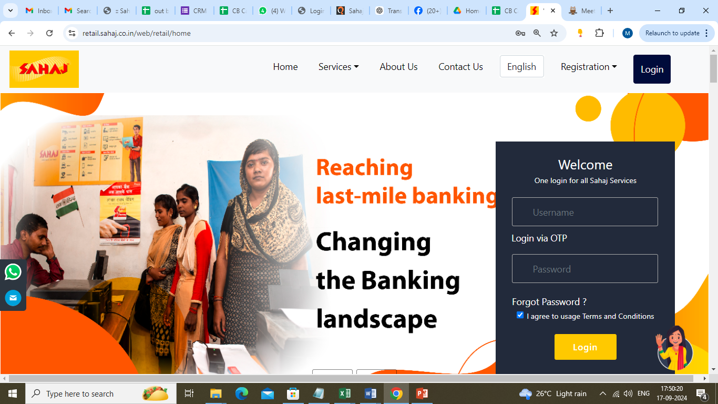
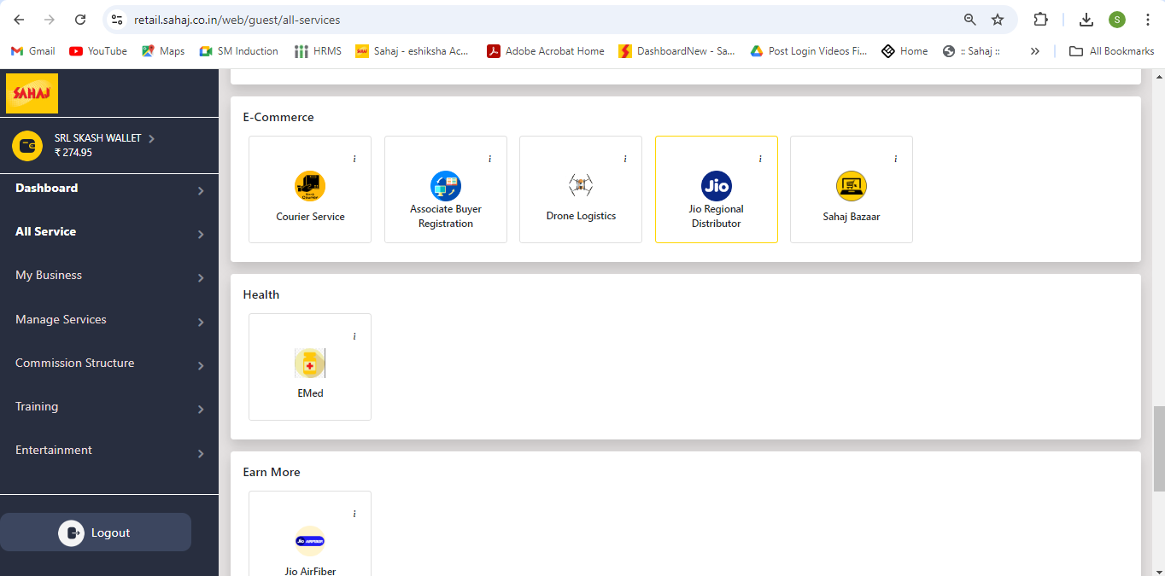
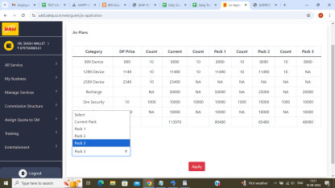
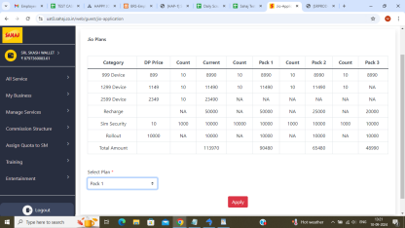
Portal Process (Login > Jio Regional Distributor > Select Plan)
1
2
3
4

Slide 9
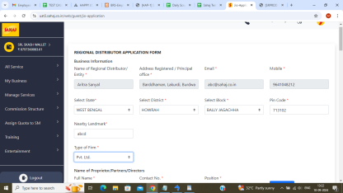
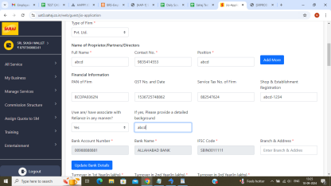
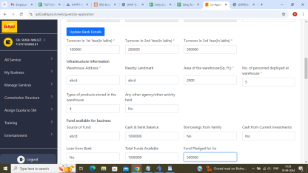
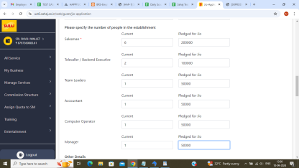
Portal Process (Fill up REGIONAL DISTRIBUTOR APPLICATION form)
5
6
7
8

Slide 10
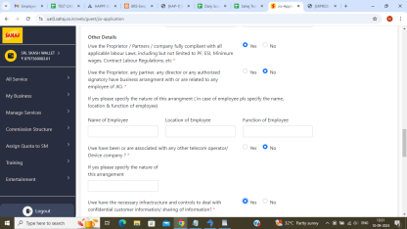
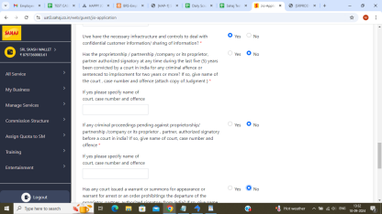
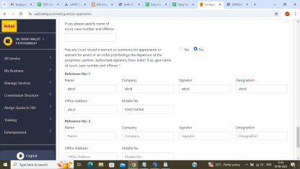
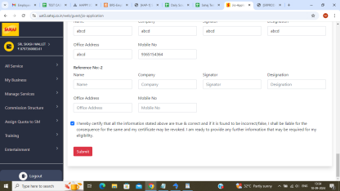
Portal Process (Submit after providing all the details)
9
10
11
12

Slide 11
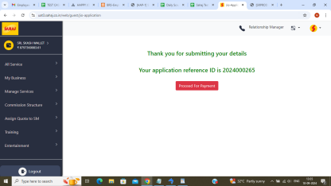
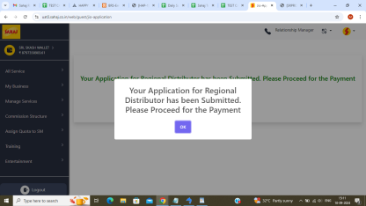
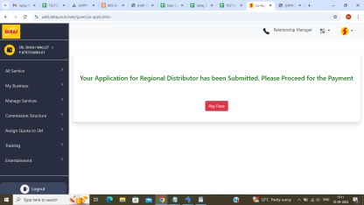
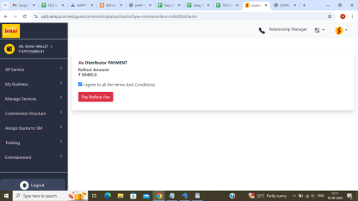
Portal Process (Proceed for Payment)
13
14
15
16

Slide 12
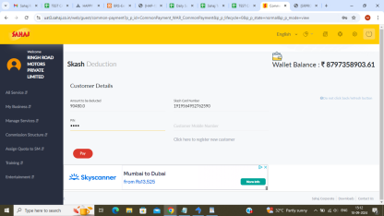
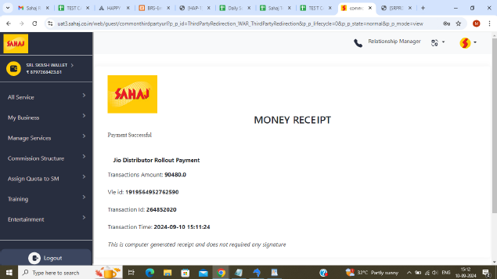
Portal Process (Make Payment from SKASH)
17
18
SAMPLE LEDGER REPORT

Slide 13
KYC and other documents
Below mentioned is the list of documents required in order to become a JIO Regional Distributor
Sl. No | Document
1 | Aadhar Card
2 | Pan Card
3 | GST /GST Decleration
4 | Address Proof
5 | Telecom Annexures & Notary (Signed & Stamped)
6 | Agreement (Notary)

Slide 14
Document format
Sl.No | Document Name | Description | Sample Doc
1 | Non GST Declaration | Incase, GST not available this document could be used
2 | NOC DTR | RRL agreement
3 | 15- Signature Verification Letter | Signature Verification Letter signed by SM & his Bank Manager
4 | 10- Certification Annexure | Reliance certified redistributor certificate
5 | 8- S4 RDS Annexure _Jio phone ordering & Fulfilment Activity | Agreement to be signed by Sahaj Mitr

Slide 15
Document format
Sl.No | Document Name | Description | Sample Doc
6 | 7- P2 RCV Annexure _Electronic Recharge & Recharge Voucher | Agreement to be signed by Sahaj Mitr
7 | 6- S1 Telecom Annexure | Agreement to be signed by Sahaj Mitr
8 | 5- P 1 Device Annexure | Agreement to be signed by Sahaj Mitr
9 | 4B Undertaking Content on stamp paper | Agreement to be signed by Sahaj Mitr
10 | 4A Undertaking | Agreement to be signed by Sahaj Mitr

Slide 16
Document format
Sl.No | Document Name | Description | Sample Doc
11 | 2- Certification Application Form | Application for regional distributor certification program
12 | 1B- Regional Distribution Agreement | Agreement to be signed by Sahaj Mitr
13 | 1A RDS Notary for Principle Agreement | Notary Form
14 | MSME Declaration | Agreement to be signed by Sahaj Mitr

Slide 17
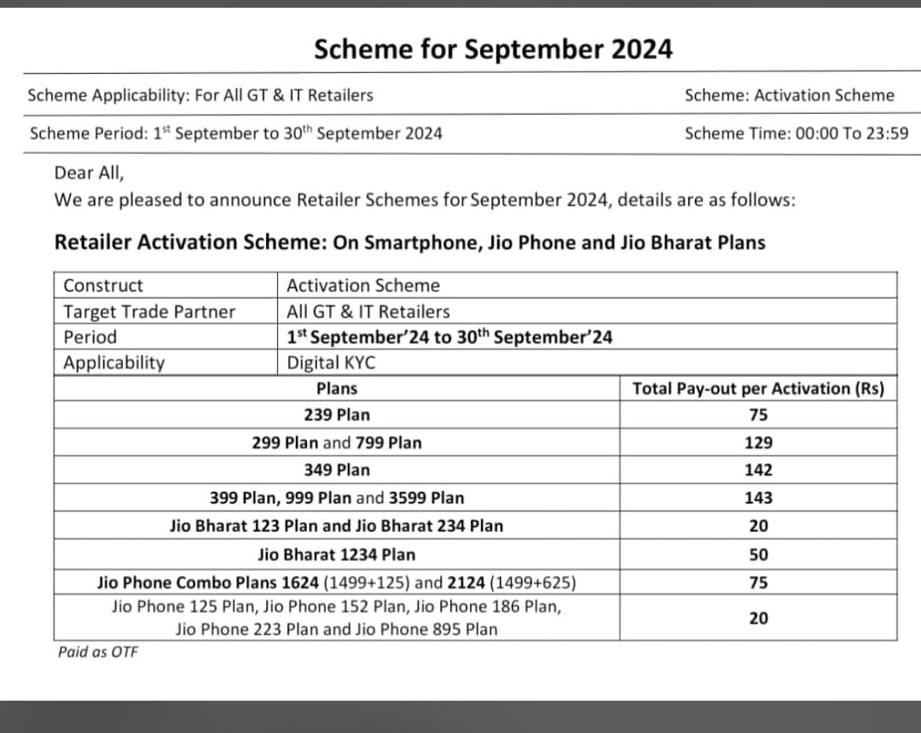
Commission Structure
Service | Distributor Commission | Retailer Commission
Recharge | 0.80% extra on every recharge | Depends on distributor
FRC (New Sim Activation) | Average INR 18/- | Up to INR 130/-
MNP | Flat INR 5/- | Flat INR 100/-
Distributor and retailer commission
FRC Plans and commission for Retailers

Slide 18
Earning Opportunity RD & Retailer
Particulars | Rate | RD Earning | Retailer Earning | Weightage | Remarks
999 Mobile | 899 | 31 | 69 | 60% | 60% of phones will be 999
1299 Mobile | 1149 | 51 | 99 | 30%
2599 Mobile | 2349 | 71 | 129 | 10%
Recharge Commission | 0.80% | 0.10% | 0.70% | 70% | ** Retailer earning % depends on RD
SIM Charges (Refundable) | 10 | 0 | 0 |  | Rs 10 per SIM, refunded on Activation
FRC | 250 | 18 | 75 | 60% | First Recharge SIM
MNP | 250 | 5 | 100 | 40% | MNP with new SIM
Monthly Earning | Assumption | RD | Retailer | Working Capital
Retailers | 10 |  |  |  | RD makes 10 Retailers
Mobile Sale Per Retailer | 10 | 4100 | 840 | 146567 | Each Retailer sells 10 phones
Recharge Per Retailer | 10000 | 100 | 70 | 100000
SIM Per Retailer | 100 | 0 | 0 | 1000 | INR 10/- refundable on each activation
FRC Per Retailer | 60 | 10800 | 4500 | 150000 | 60% New SIM - FRC
MNP Per Retailer | 40 | 7200 | 4000 | 100000 | Rest for MNP
TOTAL |  | 22200 | 9410 | 497567
Investment |  | 20990 | 0
Approx Earning on Initial Investment |  | 1591 | 0 |  | Refer Plan 4 Earning
ROI in First Month |  | 113%
Return of Capital |  | 4.46%

Slide 19
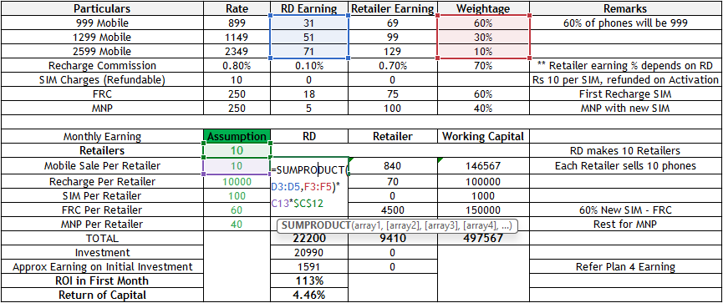
Calculation - RD earning on Mobile Sale

Slide 20
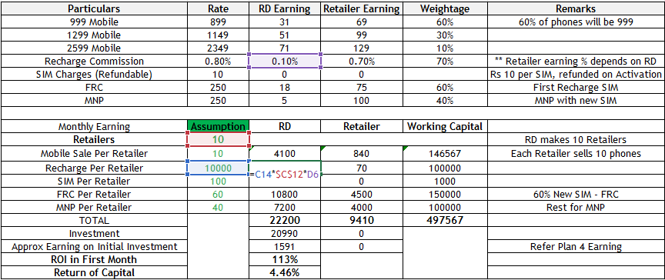
Calculation - RD earning on Recharge

Slide 21
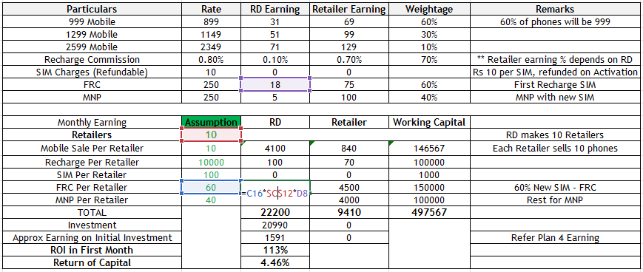
Calculation - RD earning on FRC

Slide 22
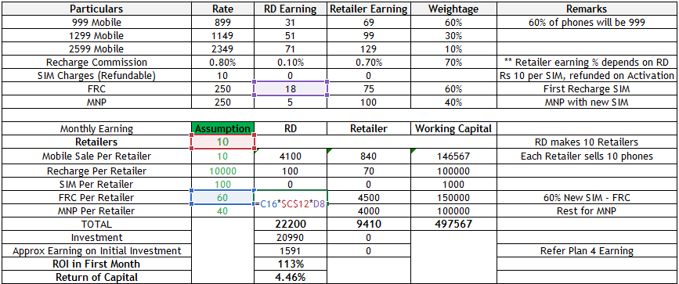
Calculation - RD earning on MNP

Slide 23
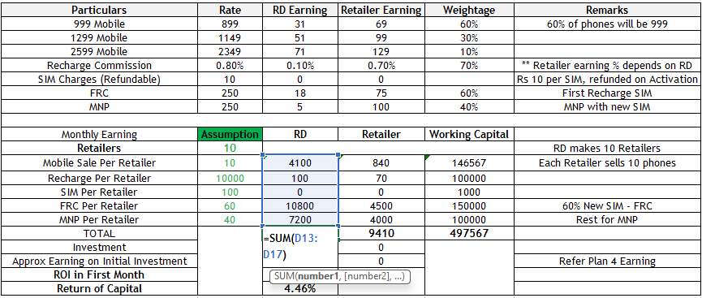
Calculation - RD Total earning

Slide 24
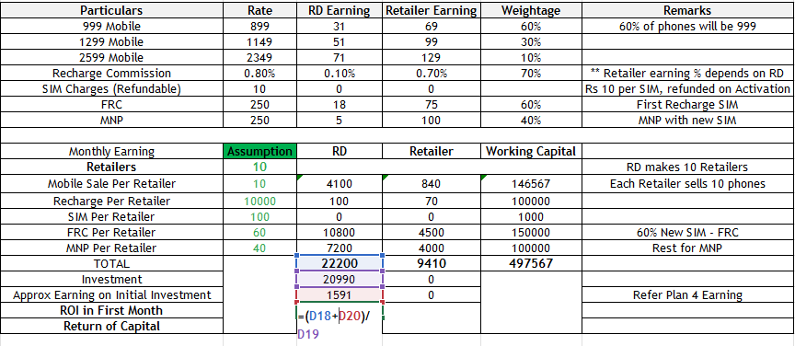
Calculation – RD 1st month ROI (113%)

Slide 25
Sample Earning Opportunity with Plan 4
Let us assume the Regional Distributor gets onboarded with INR 20990/- plan
Scenario 1 | RD Investment | RD Extra Earning
Plan 4 | 20990 | 1591
 | Count/Amount | RD Extra Earning
Mobile Device | 10 mobile | 310
Recharge Per Retailer | INR 1000 | 1
SIM Per Retailer | 100 Sim Card | 0
FRC Per Retailer | 60 Sim Card | 1080
MNP Per Retailer | 40 Sim Card | 200

Slide 26
Frequently Asked Questions
1. Can a distributor appointed by Sahaj work in an area where there is existing JIO distributor available?
Ans - Yes, Distributor appointed by Sahaj can work in the current JIO distributor’s area.
2. Is GST Mandatory?
Ans - GST is required. However, initially the distributor can provide a declaration to start the business and apply for GST simultaneously.
3. What will the distributor get after making payment?
Ans – The distributor will get mobile handset device, recharge amount & SIM cards.
(**The count of the items will be as per the pack purchased while onboarding)
4. Whis mobile handset devices will be provided for selling?
Ans - Jio Bharat 999 & Jio Bharat 1299 models will be provided.
5. What is the commission on recharge?
Ans - Commission on recharge is 0.8% including retailer margin.

Slide 27
Frequently Asked Questions
6. Does this distributorship include JIO SIM Card replacement?
Ans - No, SIM replacement can only be done at Jio Point or Jio Centre.
7. Whom to contact for warranty?
Ans - Customers need to take the device to the nearest Jio Service Centre for warranty related issues.
8. What will be the area of distributorship?
Ans – A distributor can work in his district and subdistrict.
9. How much time does it takes to onboard a Jio distributor?
Ans - After receiving all signed & stamped documents, the onboarding will be completed within 4-5 working days. Any rejection will require fresh resubmission of documents.
10. What is the process of Jio retailer onboarding and documentation?
Ans – The entire process of Jio retailer onboarding and documentation will be done by distributors with the credentials provided to them to login to JIO portal.

Slide 28
Frequently Asked Questions
11. What is MNP in SIM card?
Ans - Mobile number portability (MNP) enables any user to switch from one operator to another while retaining their original mobile number.
12. What is the commission on MNP (Mobile Number Portability) of retailer and distributor?
Ans - For retailers, MNP margin is INR 100/- and for distributors it is INR 5/-.
13. Do we need to maintain any balance in Jio distributor or retailer portal?
Ans - No.
14. What is the full form of FRC in Jio?
Ans –FRC stands for “First Recharge Coupon". It's a mandatory step in the process of activating a Jio SIM card.
15.Whom should the distributor contact for JIO portal recharge reloading?
Ans – Sahaj.
16. What are the services the distributor can provide to the retailer?
Ans - JIO Mobile Handset, New connection & MNP through SIM , Recharge

Slide 29
Thank you

