Slide 1
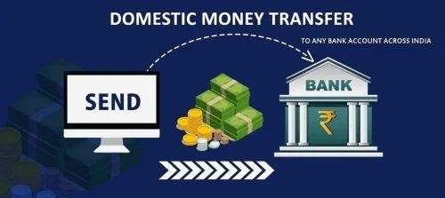
Sahaj DMT Services
For internal training& circulation
1

Slide 2
The need of transferring money can arise at anytime & anywhere.
It often arises during non-banking hours.
USP’S OF DMT SERVICE
Domestic Money Transfer(DMT) is the service by which any one can send money by registering their mobile no across India with ease.
For internal training& circulation
2

Slide 3
USP’S OF DMT SERVICE
Easy to use.
Safe and secure payment method.
Interoperable across various banks.
Encourages financial inclusion and serves the under banked sections of society.
It is a completely safe and secure process as DMT transactions require the account holder’s Account
number & registered mobile number.
It increases the reach to rural areas as banking executives can now reach distant rural places with DMT service.
No limitations on adding Beneficiary from single mobile no. of the sender.
Maximum money transfer limit per month, per mobile no. Rs.25k.
For internal training & circulation
3

Slide 4
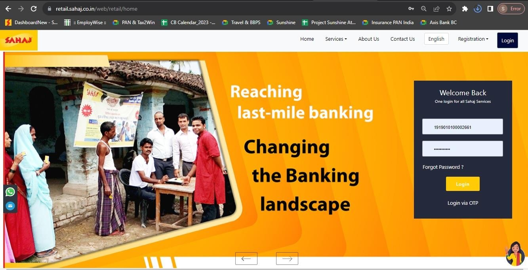
DMT – PORTAL PROCESS
SM to login with user id and password
For internal training & circulation
4

Slide 5
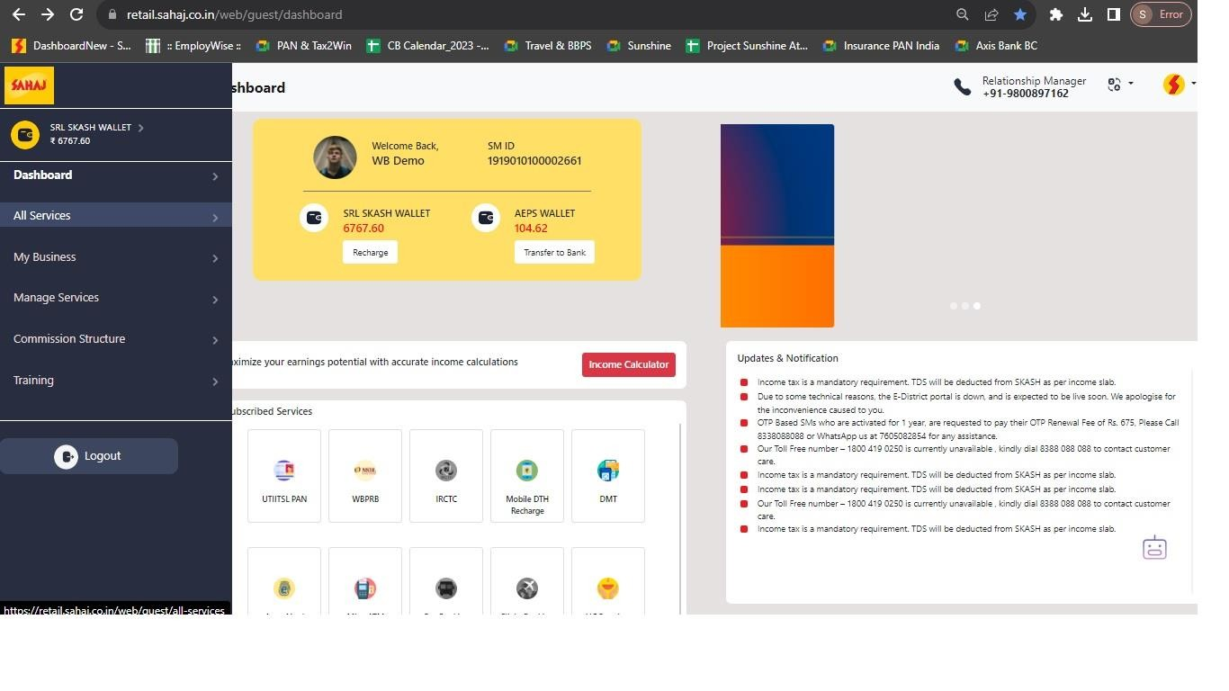
DMT – PORTAL PROCESS
SM will click on “All Services”
For internal training& circulation 5

Slide 6
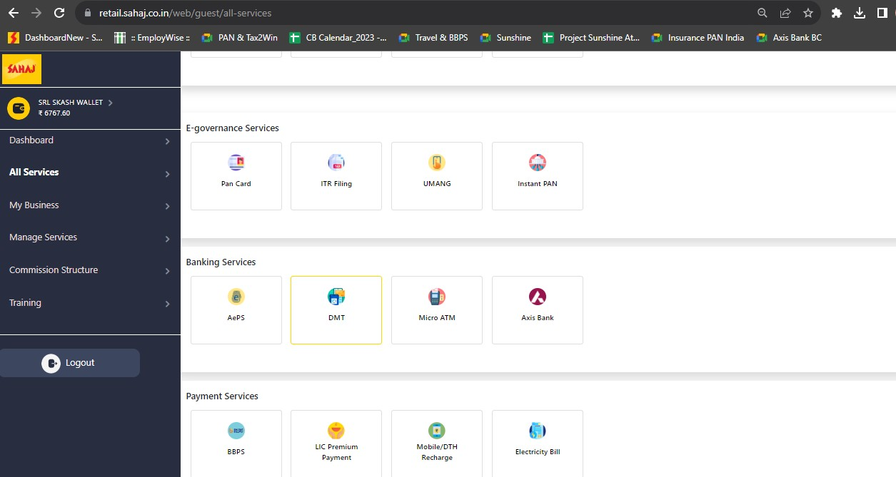
DMT – PORTAL PROCESS
SM will click on “DMT”

Slide 7
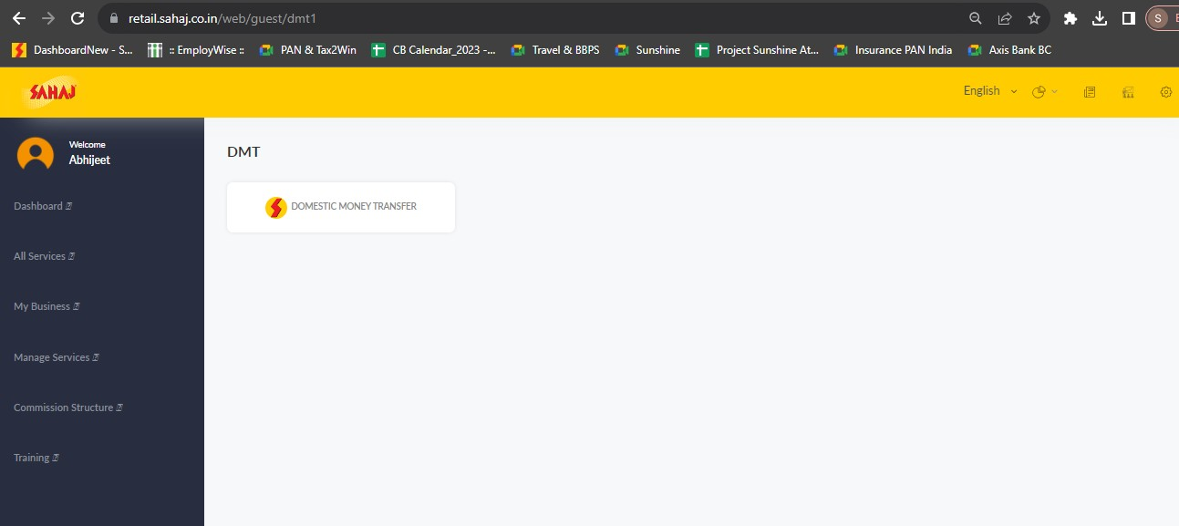
DMT – PORTAL PROCESS
SM will click on “Domestic Money Transfer”

Slide 8
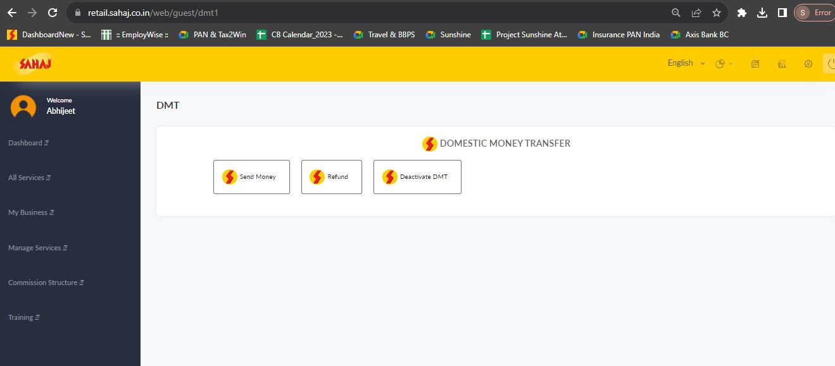
DMT – PORTAL PROCESS
SM will click on “Send Money”

Slide 9
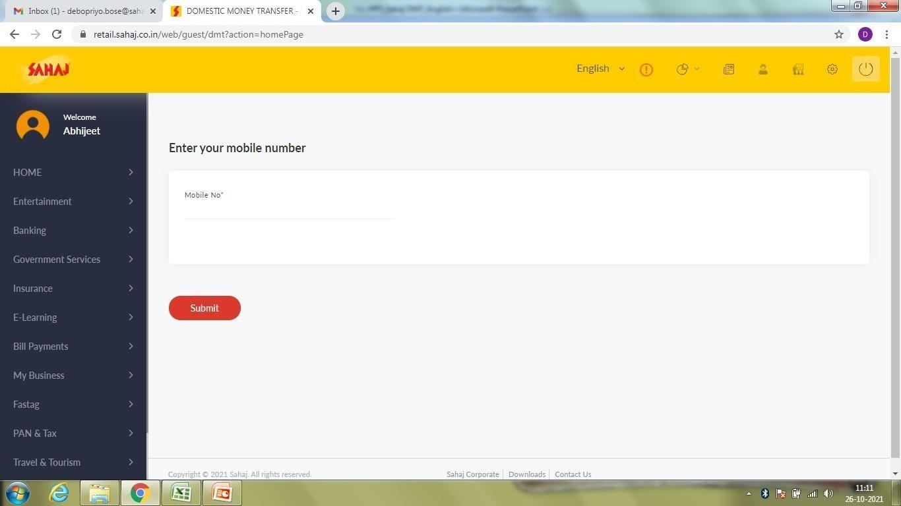
DMT – PORTAL PROCESS
SM will enter his own mobile no. and click on submit
XXXX
For internal training & circulation
8

Slide 10
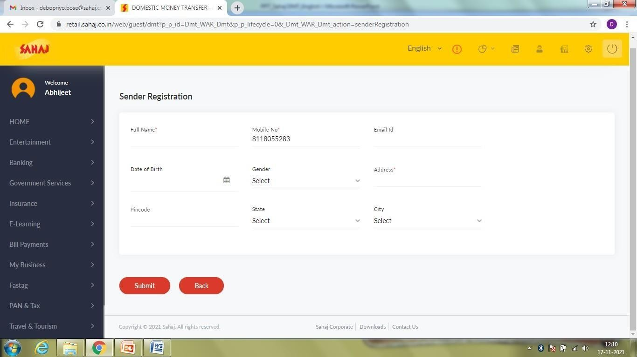
DMT – PORTAL PROCESS
Sender will need to fill up the details to register himself for DMT process
For internal training& circulation 9

Slide 11
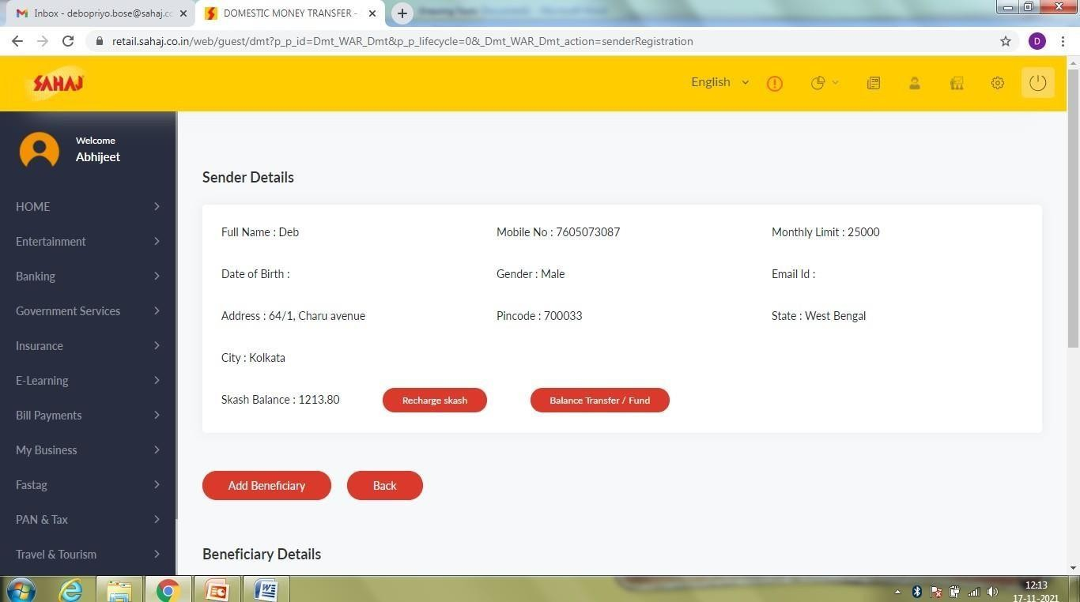
DMT – PORTAL PROCESS
After successful registration the Sender will be able to add beneficiary under his mobile no.
SM will click on “Add Beneficiary”
For internal training & circulation
1
0

Slide 12
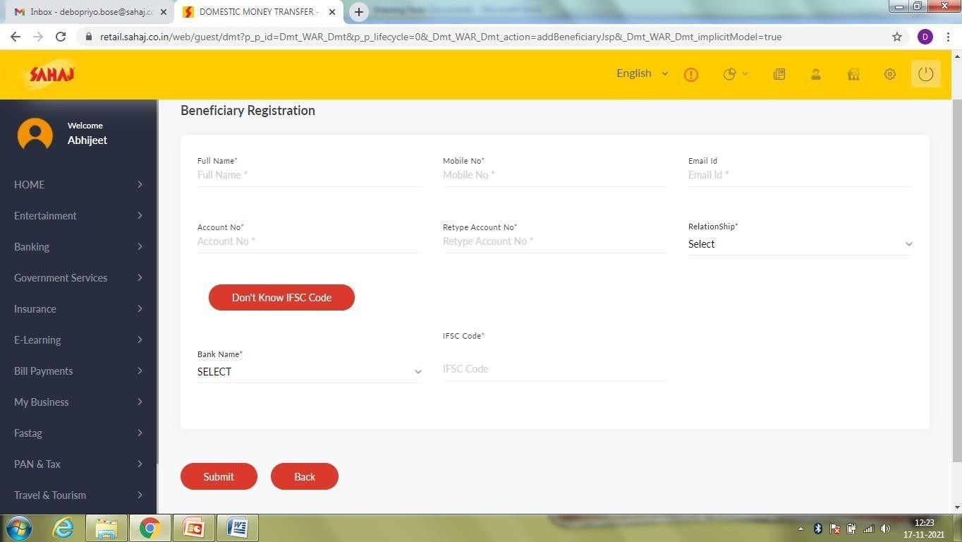
DMT – PORTAL PROCESS
XXX
XXX
XXX
XXX
XXX
XXX
SM will fill up all the required details. IFSC code is not mandatory
XXX
XXX
For internal training & circulation
1
1

Slide 13
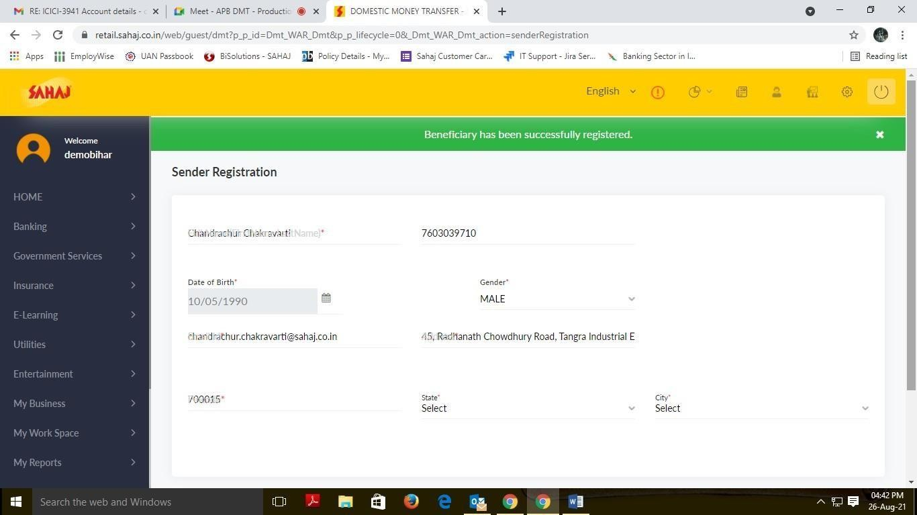
DMT – PORTAL PROCESS
Beneficiary has been added successfully
XXX
XXX
XXX
XXX
XXX
XXX
XXX
For internal training & circulation only 13

Slide 14
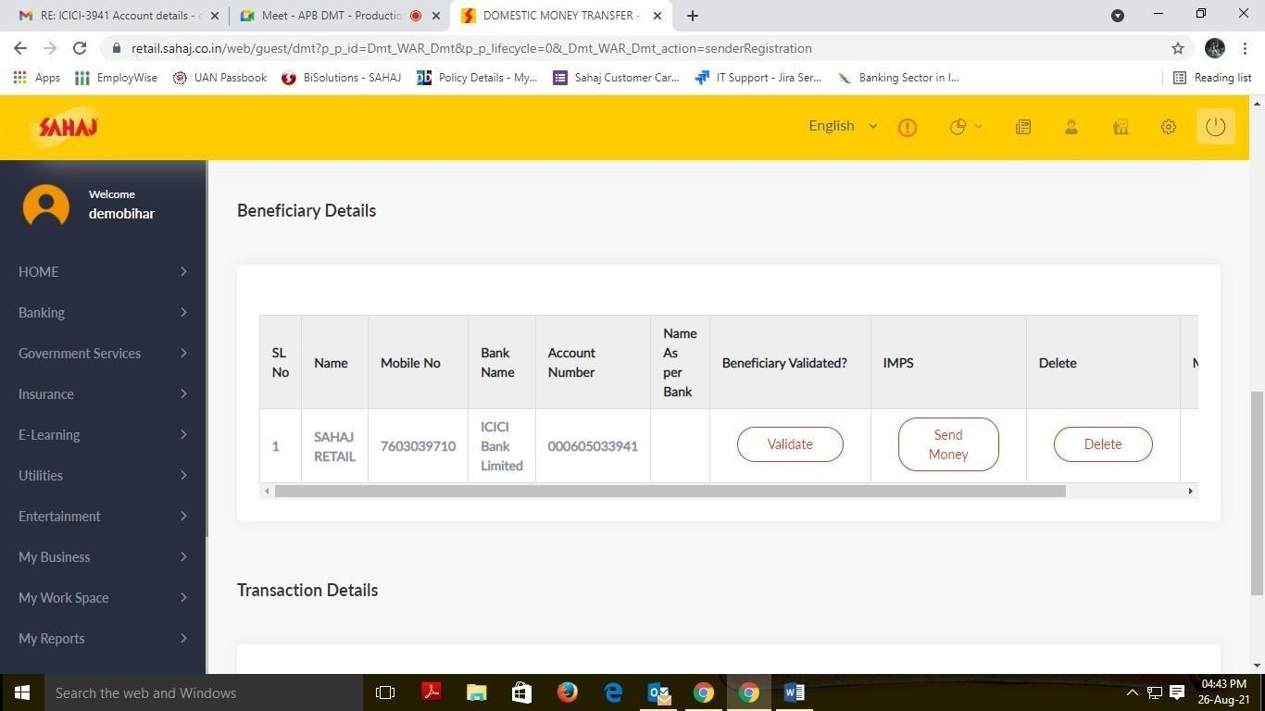
DMT – PORTAL PROCESS
The details of the Beneficiary can be seen. The sender needs to validate the account for DMT process.
Sender also has the option to delete or modify an account.
For internal training & circulation
1
4

Slide 15
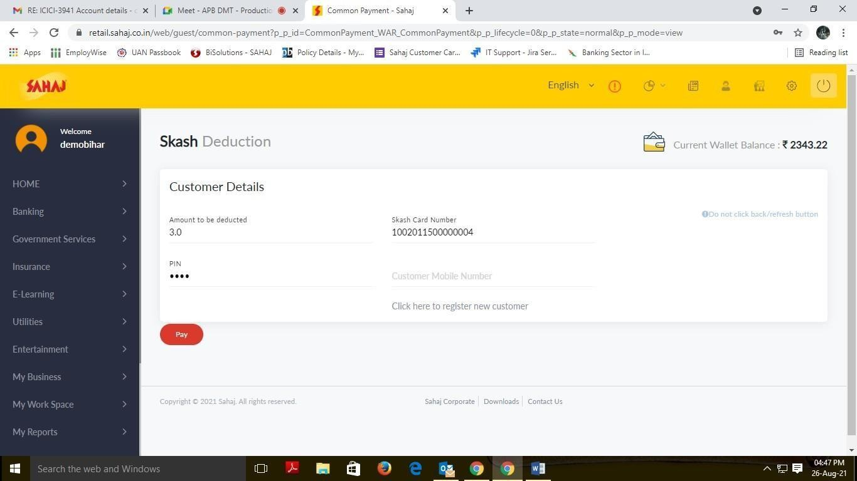
DMT – PORTAL PROCESS
SKASH will be deducted with Rs 3/-
For internal training & circulation
1
5

Slide 16
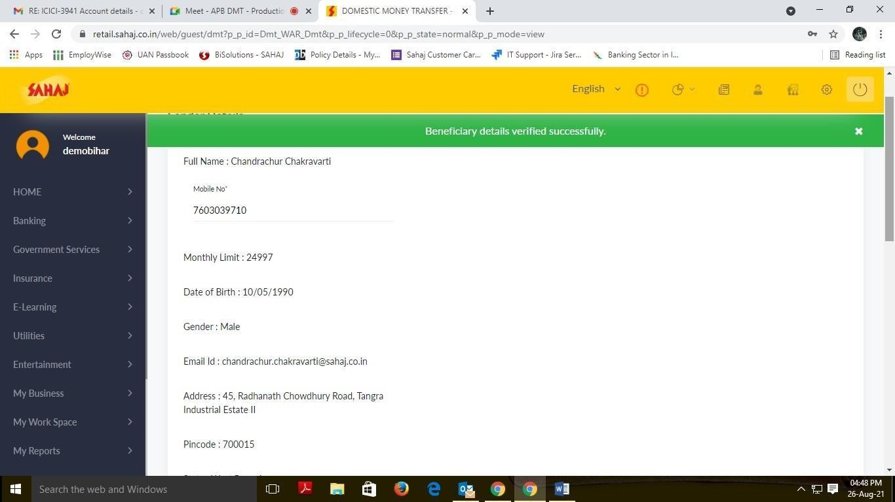
DMT – PORTAL PROCESS
After successful SKASH deduction, beneficiary will be validated successfully
For internal training & circulation
1
6

Slide 17
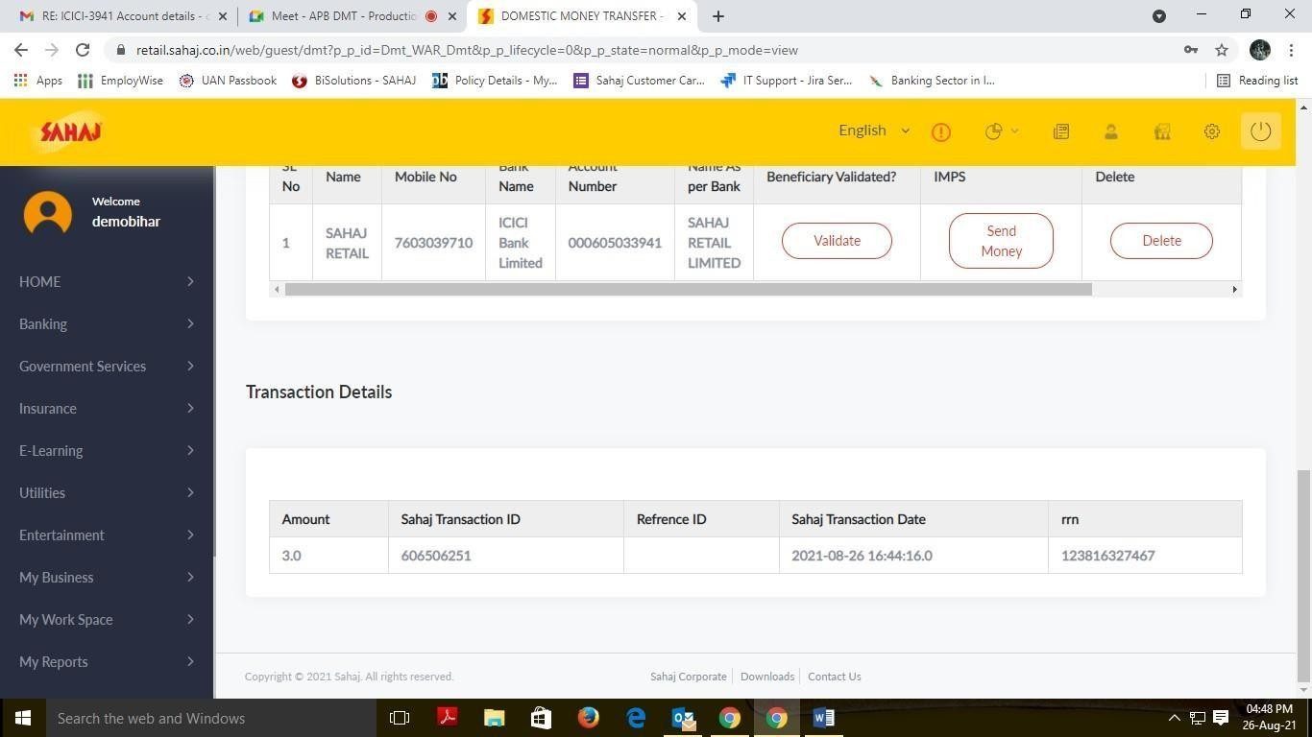
DMT – MONEY TRANSFER
For sending money, click on the ‘Send Money’ option
For internal training & circulation
1
7

Slide 18
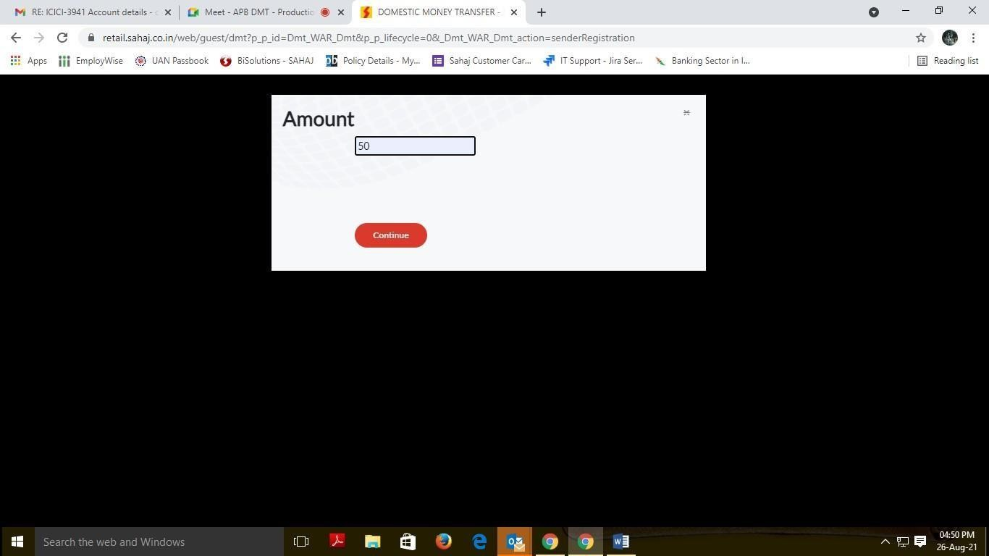
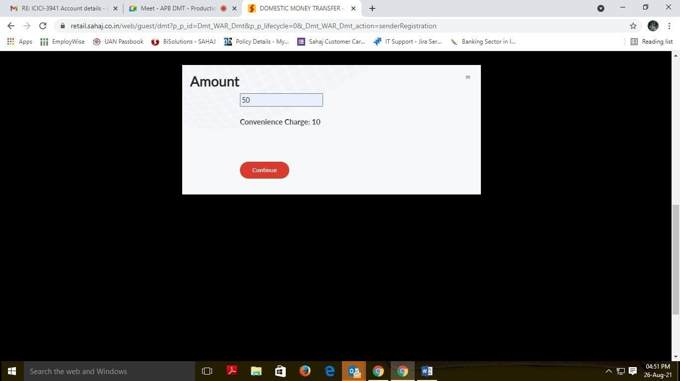
DMT – MONEY TRANSFER
Fill up amount. Once amount is filled the convenience charge will be shown accordingly
For internal train
ing & circulation 18

Slide 19
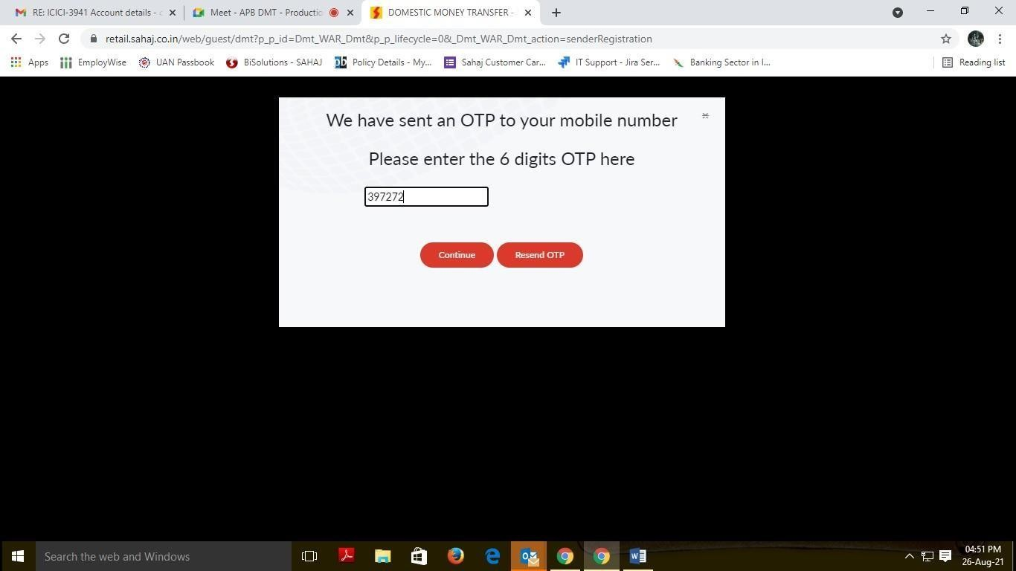
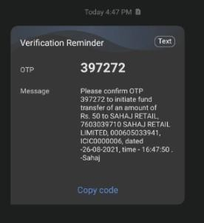
DMT – MONEY TRANSFER
Sender will receive an OTP to confirm the deduction from his account. This will happen only for the
first time. From next time onwards no OTP will be required for the same Beneficiary
The sender will receive an OTP to
authenticate the transaction.
For internal training & circulation
1
9

Slide 20
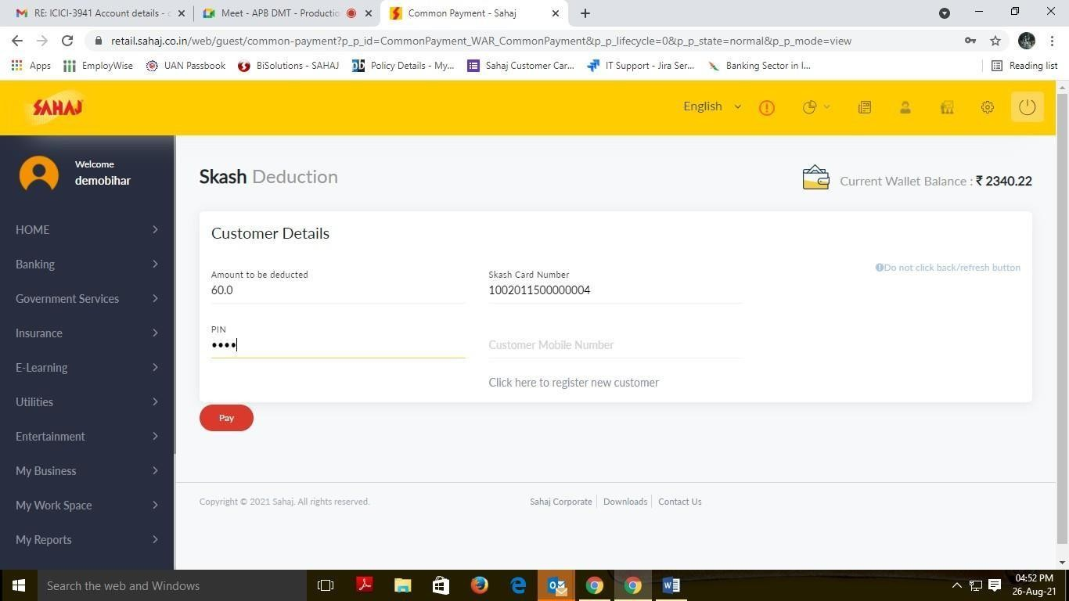
DMT – MONEY TRANSFER
SKASH deduction
For internal training & circulation
2
0

Slide 21
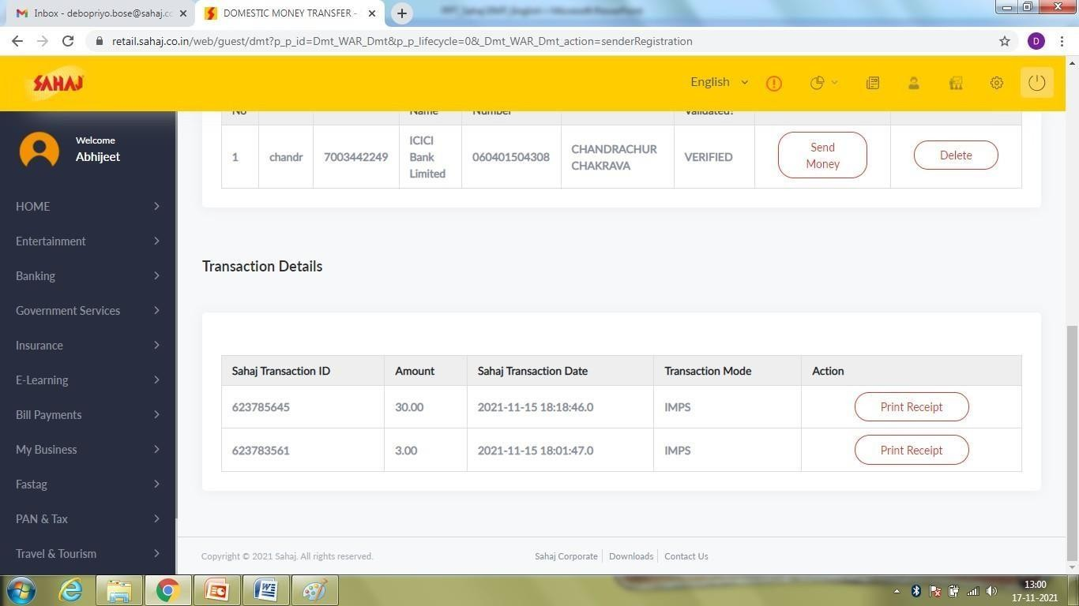
DMT – MONEY TRANSFER
SM can view the transaction details of the sender. SM will click on “Print Receipt” option.
For internal training& circulation 21

Slide 22
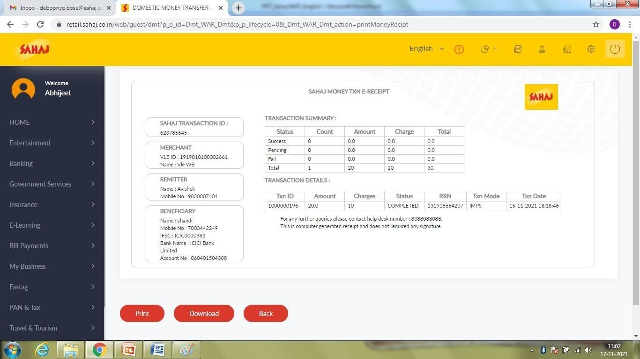
DMT – MONEY TRANSFER
Money Receipt
For internal training& circulation 22

Slide 23
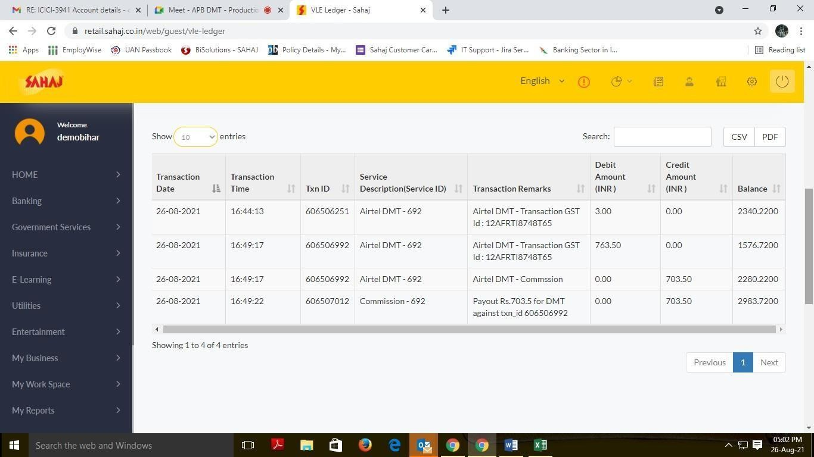
DMT – MONEY TRANSFER
SM can view the transaction details from VLE Ledger also
DMT - 692
DMT – Transaction GST id: 12AFRIT65
DMT - 692
DMT – Transaction
GST id: 12AFRIT65
DMT – Commission
DMT - 692
For internal training & circulation
2
3

Slide 24
DMT – FAQ’S
How many beneficiaries can be added under a particular contact number?
A: No limitations on adding Beneficiary from single mobile no. of the sender.
What is the Maximum money transfer limit per Month per mobile number?
A: 25 k.
Does the VLE / Sender needs to register his phone no. to proceed further?
A: Yes.
Can we transfer money during non banking hours?
A: Yes, at anytime.
What does the sender have to do to validate the account of the beneficiary?
A: The sender will send Re 1/- to validate the account of the beneficiary,After successful SKASH
deduction, beneficiary will be validated successfully.
For internal training& circulation
25

Slide 25
DMT – FAQ’S
What is the Minimum amount of transaction?
A: Minimum amount starts from Rs.10.
Does the Sender require a Bank Account?
A: No, sender Bank account details is not captured anywhere & not mandatory to have an account.
What will happen if the balance is deducted from the wallet but not transferred to receiver account?
A: following scenarios may happen :-
Amount debited from Skash, but txn failed – Skash auto-reconciles after every 15-20 mins. Any failed transaction data will be credited automatically.
Amount debited from skash, txn under process stage.
Awaiting txn. gets successful within next 30mins -48 hours, as per Bank’s response. No issues.
Awaiting txn. gets failed within next 30mins -48 hours, as per Bank’s response.
Admin team from HO will raise the failed txn data as received from partner bank in portal to raise the refund request. The sender will receive an SMS in his registered mobile no. containing an OTP when refund request is initiated & sender needs to visit the SM & share the OTP for refund. SM’s Skash will be credited with the refund amount & the former can hand over the physical cash to Sender again.
For internal training& circulation
26

Slide 26
DMT – FAQ’S
What is the TAT for refund process for failed transaction?
A: After 48 hours maximum Bank sends us the response for “Txn in Process” final status. If success there is no issue, if failed, then TATfor refund is another 24 hours, post which sender will receive an SMS containing an OTP to collect money from the SM point where the transaction was initiated.
What will be the commission Frequency?
A: Instant to his skash, if the transaction is success.
Additional questions…For Chargeback cases (where amount transferred into wrong account), SMs should connect with their respective Sahaj representative with all details. HO will send chargeback to Partner Bank, where 35 days is normal TATas per NPCI. however 99% cases response is customer not reachable.
Txn successful, but customer account not credited. Beneficiary Passbook with IFSC code visible, updated txn history in passbook (up-to-date) should be shared with Sahaj, who will contact Partner Bank.. TAT5 days.
Fraudulent cases – When SM’s DMT txn Password / PIN is shared & un-authorized txn took place (fraudster transferring amount in his own account instead of beneficiary), then complaint with FIR report should be submitted. No specific TATfor resolution.
For internal training& circulation
27

Slide 27
DMT – COMMISSION STRUCTURE
DMT Commission Slab
REMIT AMT | CUST CHRG | SM PAY (in Rs.) |  | REMIT AMT | CUST CHRG | SM PAY (in Rs.) |  | REMIT AMT | CUST CHRG | SM PAY (in Rs.)
10-1000 | 10 | 3.42 |  | 10010-10500 | 105 | 45.22 |  | 19510-20000 | 200 | 88.26
1010-1500 | 15 | 5.75 |  | 10510-11000 | 110 | 47.55 |  | 20010-20500 | 205 | 89.35
1510-2000 | 20 | 8.08 |  | 11010-11500 | 115 | 49.88 |  | 20510-21000 | 210 | 91.68
2010-2500 | 25 | 10.41 |  | 11510-12000 | 120 | 52.21 |  | 21010-21500 | 215 | 94.01
2510-3000 | 30 | 12.74 |  | 12010-12500 | 125 | 54.54 |  | 21510-22000 | 220 | 96.34
3010-3500 | 35 | 15.07 |  | 12510-13000 | 130 | 56.87 |  | 22010-22500 | 225 | 98.67
3510-4000 | 40 | 17.4 |  | 13010-13500 | 135 | 59.2 |  | 22510-23000 | 230 | 101
4010-4500 | 45 | 19.73 |  | 13510-14000 | 140 | 61.53 |  | 23010-23500 | 235 | 103.33
4510-5000 | 50 | 22.07 |  | 14010-14500 | 145 | 63.87 |  | 23510-24000 | 240 | 105.67
5010-5500 | 55 | 23.16 |  | 14510-15000 | 150 | 66.2 |  | 24010-24500 | 245 | 108
5510-6000 | 60 | 25.49 |  | 15010-15500 | 155 | 67.29 |  | 24510-25000 | 250 | 110.33
6010-6500 | 65 | 27.82 |  | 15510-16000 | 160 | 69.62
6510-7000 | 70 | 30.15 |  | 16010-16500 | 165 | 71.95
7010-7500 | 75 | 32.48 |  | 16510-17000 | 170 | 74.28
7510-8000 | 80 | 34.81 |  | 17010-17500 | 175 | 76.61
8010-8500 | 85 | 37.14 |  | 17510-18000 | 180 | 78.94
8510-9000 | 90 | 39.47 |  | 18010-18500 | 185 | 81.27
9010-9500 | 95 | 41.8 |  | 18510-19000 | 190 | 83.6

Slide 28
For internal training& circulation
28

